Slide 1
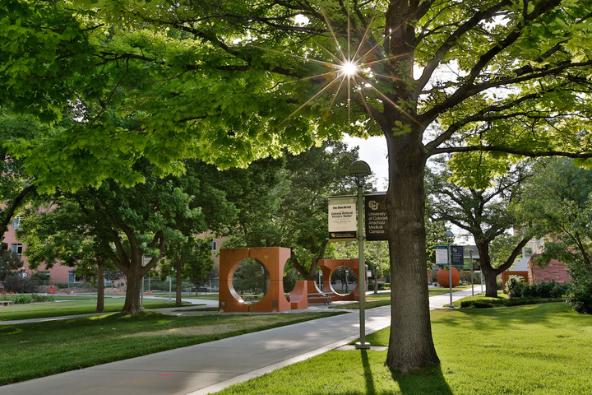

Neural Interfaces and Bionic Limbs Spring 2024
Linear Discriminant Analysis (LDA): EMG Pattern Recognition & Classification
Timothy Young, Erin Radcliffe, Sari Younan, Fai Au
GitHub Project Repo
Notes:
According to IBM, Linear Discriminant Analysis or LDA is an approach used in supervised machine learning to solve multi-class classification problems.

Slide 2
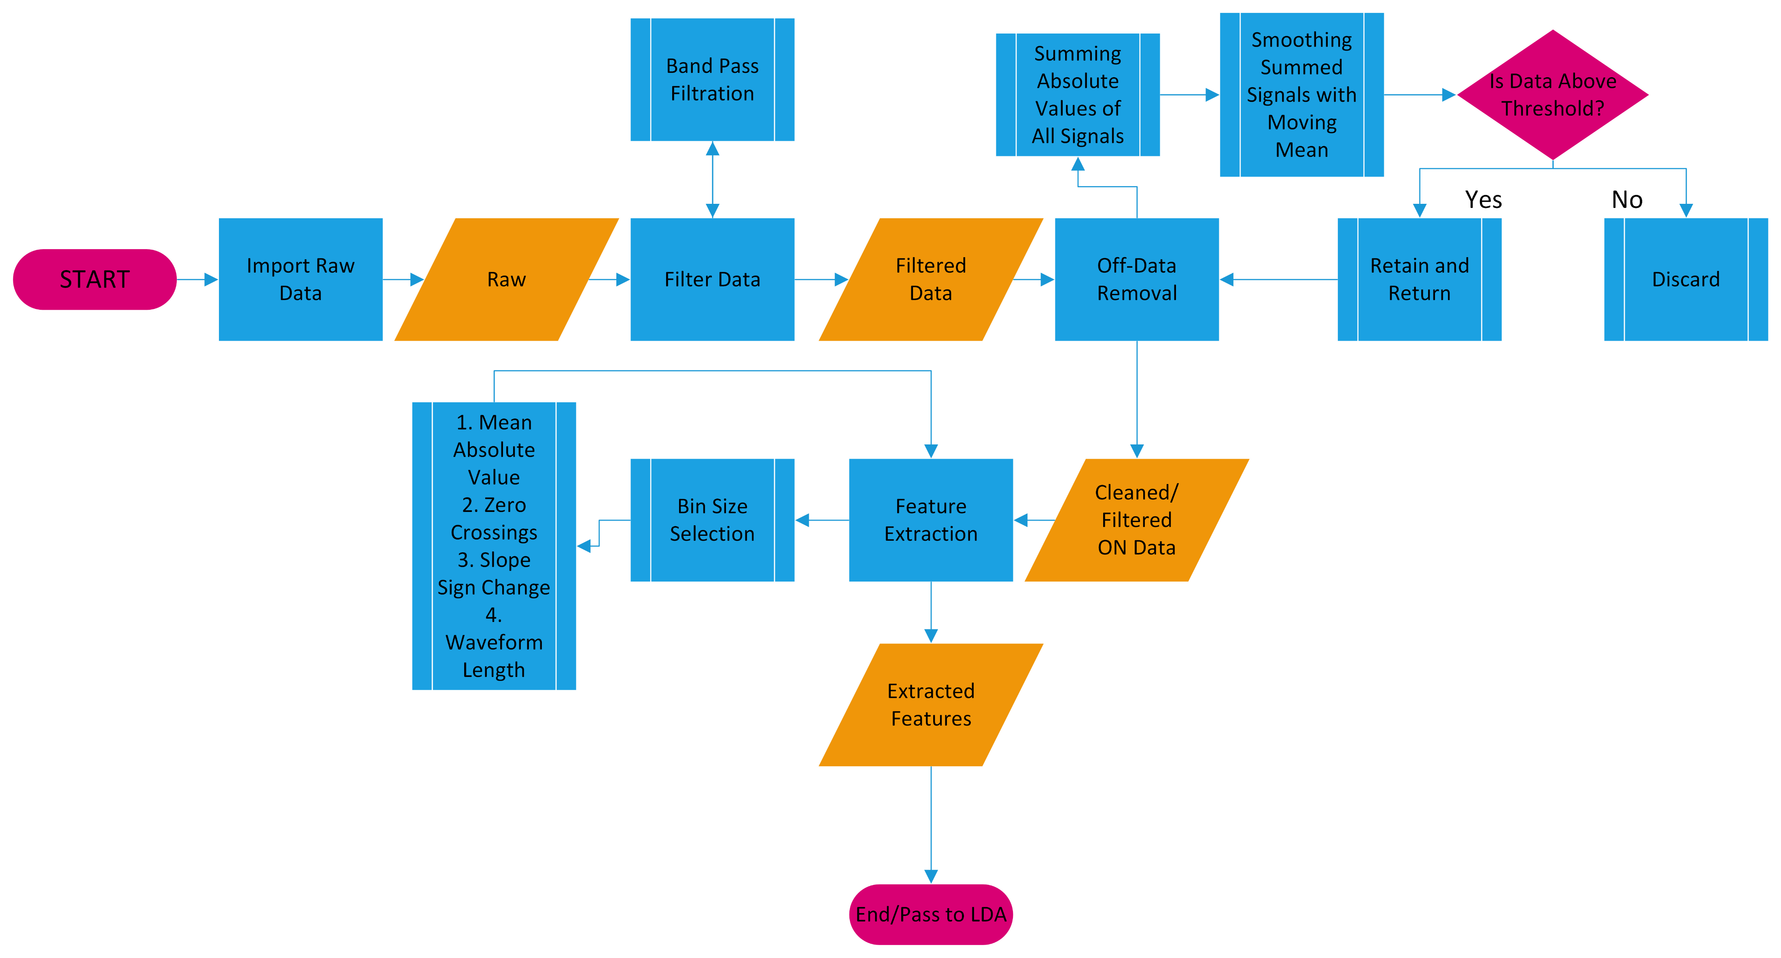
Program Architecture – UML diagram
Notes:
ER Input Data:
- given Training Data and Validation, each contain 11 postures, 8 EMG channels, 6 trials per posture
Data Processing
- Filter data (band pass filter ~30-480 Hz, notch/comb filter @ 60 Hz + harmonics)
- “Off” data removal
- Quiescent data removal
Feature Extraction:
- MAV, SSC, ZC, WL
- Bin size selection: 50ms
Output Data Structure
Mean and SD calculations/sub calculations
Sb, Sw, O matrices
Eigenvector and Eigenvalue computations
W matrix (transformation matrix)
LDA Classification
LDA Confusion Matrix

Slide 3
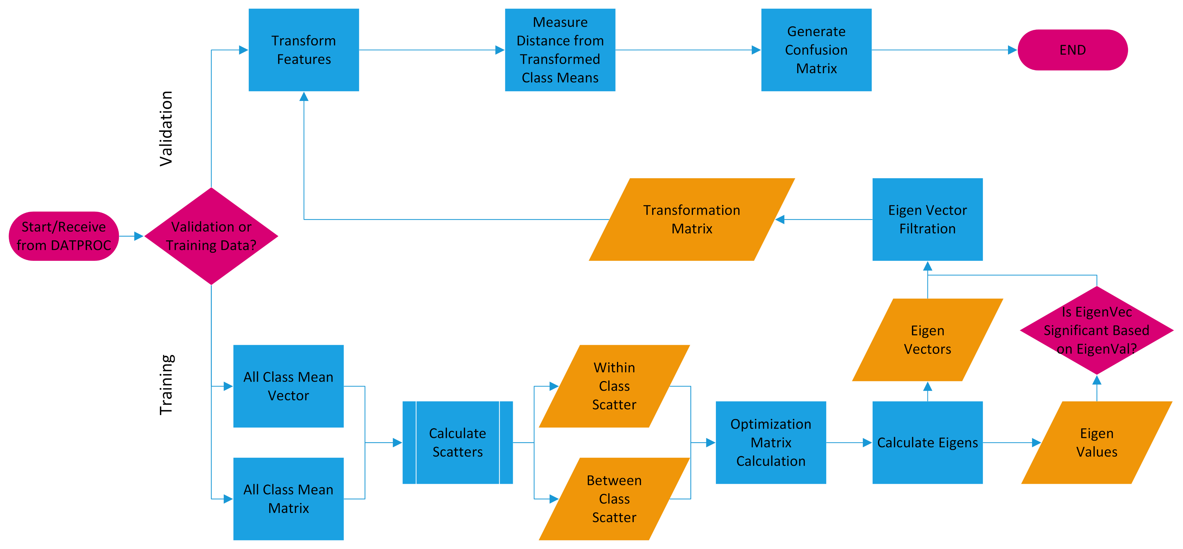
Program Architecture – UML diagram
Notes:
ER
Input Data:
- given Training Data and Validation, each contain 11 postures, 8 EMG channels, 6 trials per posture
Data Processing
- Filter data (band pass filter ~30-480 Hz, notch/comb filter @ 60 Hz + harmonics)
- “Off” data removal
- Quiescent data removal
Feature Extraction:
- MAV, SSC, ZC, WL
- Bin size selection: 50ms
Output Data Structure
Mean and SD calculations/sub calculations
Sb, Sw, O matrices
Eigenvector and Eigenvalue computations
W matrix (transformation matrix)
LDA Classification
LDA Confusion Matrix

Slide 4
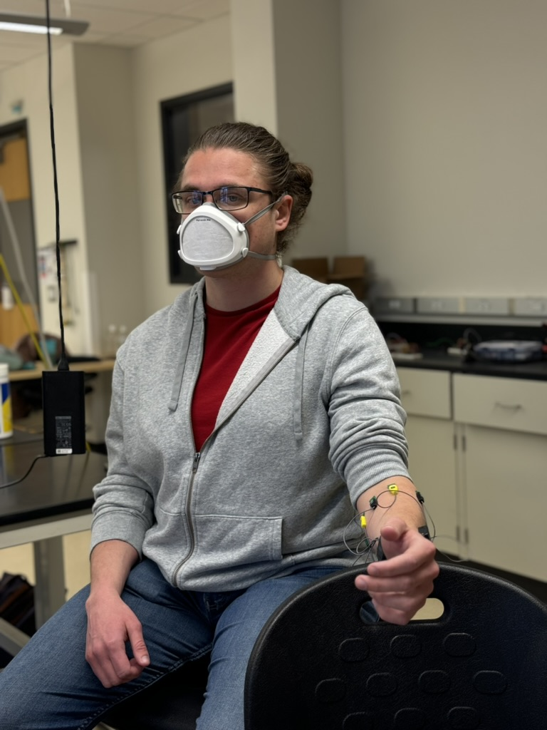
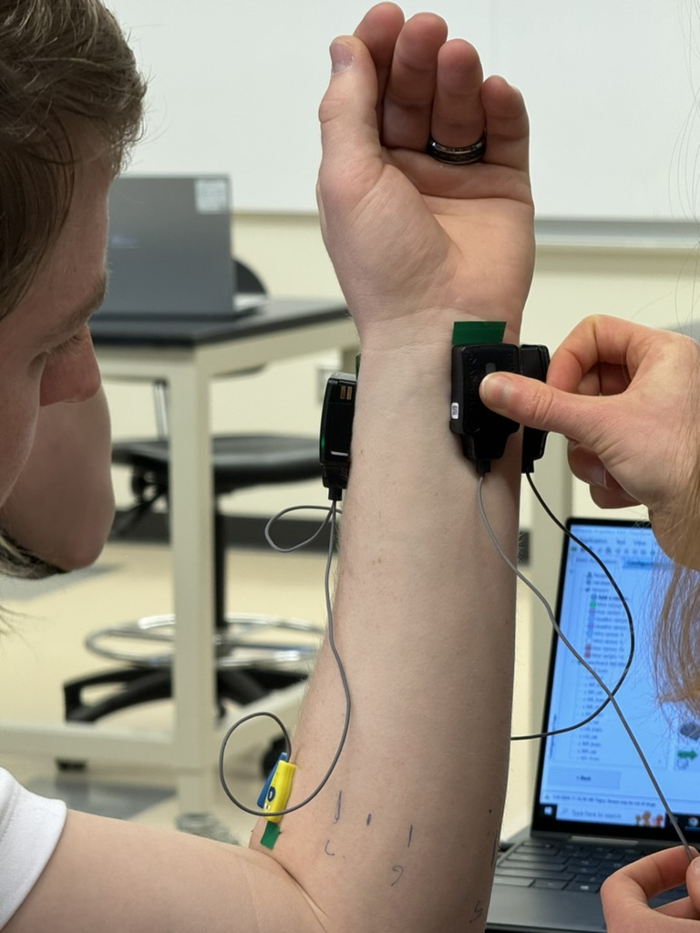
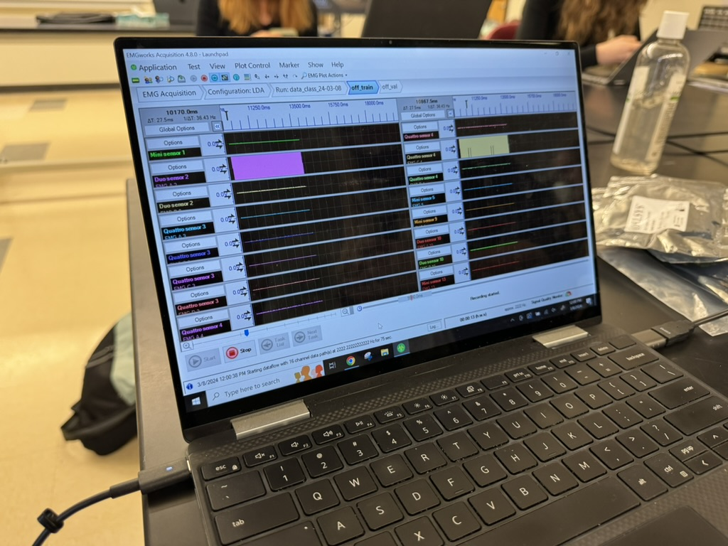
Raw Data Collection – Group 1 Quatros
Notes:
11 postures, 8 EMG channels, 6 trials per posture

Slide 5
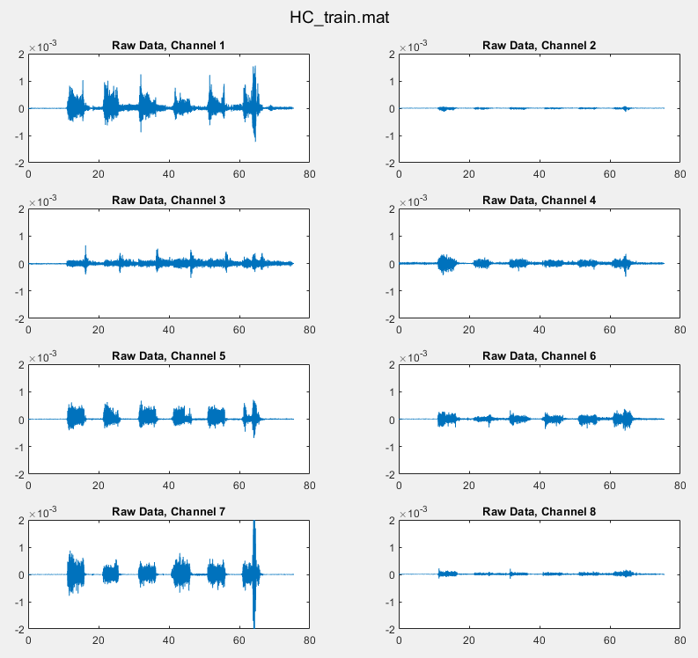
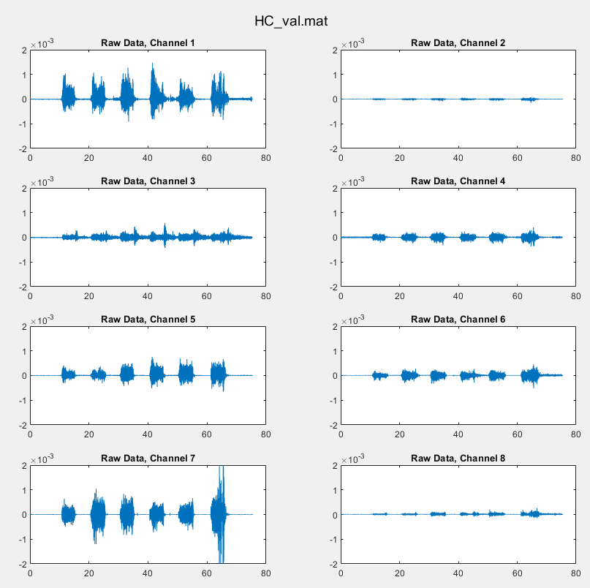
Representative Raw Data for Single Posture (Hand Close)
Notes:
%% MatLab directory organization
clear all; close all; clc;
main_dir = 'C:\MATLAB\GitHub\EMG_LDA';
raw_data_dir = 'C:\MATLAB\GitHub\EMG_LDA\Group1_2024_quatro_sensors'; % Group 1 EMG
filt_data_dir = 'C:\MATLAB\GitHub\EMG_LDA\Filtered_Group1_2024_quatro_sensors'; % Filtered Group 1 EMG
cd(raw_data_dir)
%% Data exploration: load Raw EMG (Group 1) and save training and validation posture data into separate structs
mat_files = dir('*.mat');
% each mat file is a 1x1 struct (named posture) with 4 fields:
% Channels (8x25 char), Fs (2.222222167968750e+03),
% Time (8x167761 double), Data (8x167761 double)
posture_names = {'HC', 'HO', 'off', 'RD', 'Tab', 'Tad', 'UD', 'WE', 'WF', 'WP', 'WS'};
n_postures = 11;
% Raw EMG training posture data
for i = 1:n_postures
load([posture_names{1,i},'_train.mat'])
emg_train_struct.(posture_names{1,i})= posture.Data;
clear posture
end
% emg_train_struct: 1x1 struct with 11 fields, each field (posture.Data) is a 8x167761 double
clear i;
% Raw EMG validation posture data
for i = 1:n_postures
load([posture_names{1,i},'_val.mat'])
emg_val_struct.(posture_names{1,i})= posture.Data;
clear posture
end
% emg_val_struct: 1x1 struct with 11 fields, each field (posture.Data) is a 8x167761 double
% EMG training data and validation data are equivalent in dimension -->
% save all data in a single storage container
%% Save each Raw EMG mat file struct (posture) in a single cell array
n_files = length(mat_files);
allData_cellArray = cell(cell(n_files, 2));
for i = 1:n_files
% 1st col: name of file struct (posture)
allData_cellArray{i, 1} = mat_files(i).name;
% 2nd col: content of file struct (posture)
allData_cellArray{i, 2} = load(mat_files(i).name);
end
clear i;
%% Plot all channels of Raw EMG per posture
n_channels = height(allData_cellArray{1,2}.posture.Channels);
for i = 1:length(allData_cellArray)
figure(i)
for j = 1:n_channels
subplot(4, 2, j);
plot(allData_cellArray{i,2}.posture.Time(j,:), allData_cellArray{i,2}.posture.Data(j,:));
title("Raw Data, Channel "+ j);
sgtitle(allData_cellArray{i,1}, 'Interpreter', 'none');
ylim([-2e-3, 2e-3]);
end
end

Slide 6
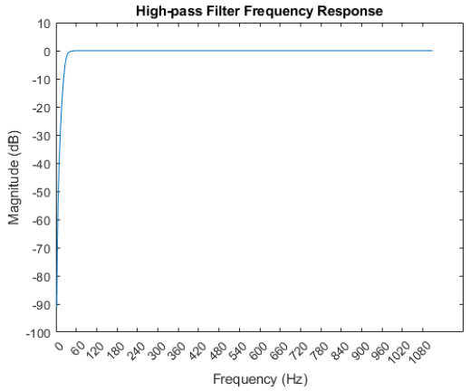
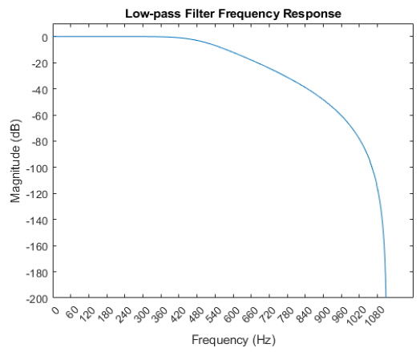
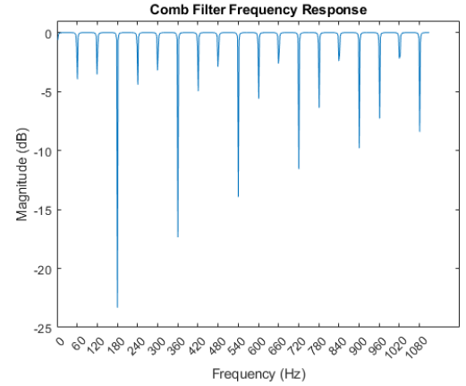
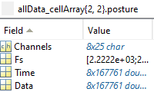
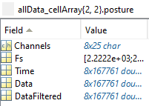
Signal Processing – Filter Design (initial method)
Input: Raw Data for each posture
Filter Design w/ cutoff frequencies
Band pass filter: ~30-480 Hz
High pass: 30Hz to remove motion artefact
Low Pass: 480Hz to bandlimit to ~500Hz
4th order Butterworth filter
Notch/Comb Filter: centered at 60Hz + harmonics (120Hz, 180Hz, 240Hz, 300Hz, 360Hz, 420Hz) up to the passband (480 Hz)
2nd order infinite impulse response (IIR) filter
Output: Filtered Data for each posture
Notes:
%% Filter Design plotting w/ cutoff frequencies
Fs = allData_cellArray{1, 2}.posture.Fs(1); % 2.2222e+03 Hz
% High Pass Filter - 30Hz to remove motion artefact - choose a multiple of 60Hz
[b_hp, a_hp] = butter(4, 30/(Fs/2), 'high'); % 4th order butterworth
% Low Pass Filter - 480Hz to bandlimit to around 500Hz - choose a multiple of 60Hz
[b_lp, a_lp] = butter(4, 480/(Fs/2), 'low'); % 4th order butterworth
% Notch Filter centered at 60Hz
f0 = 60; % Notch frequency
Q = 35; % Quality factor, q = ω0/bw where ω0 is the frequency to remove from the signal
[b_notch, a_notch] = iirnotch(f0/(Fs/2), f0/(Fs/2)/Q); % 2nd order infinite impulse response (IIR) notch filter
% Comb Filter centered at 60Hz and its harmonics (120Hz, 180Hz, 240Hz, 300Hz, 360Hz, 420Hz) up to the passband (480 Hz)
f0 = 60; % Notch frequency
bw = f0 / Q; % Bandwidth, bw = (fo/(fs/2))/q;
n_harmonics = floor((Fs / 2) / f0); % Number of harmonics within Nyquist frequency
[b_comb, a_comb] = iircomb(floor(Fs/f0), bw/(Fs/2), 'notch'); % Design comb filter
% Define quiescent threshold
quietThresh = mean(on_data(1,:)) + (0.5*std(on_data(1,:))); % Adjust multiplier as needed
% Initialize array to store 'active' data, where the muscle is not quiescent
active_data = [];
active_time = [];
% Define the bin size for iteration, could be the same as used for 'off' detection
binSize = 1.5e-3; % 1.5 ms in seconds
binSamples = round(binSize * Fs); % Convert bin size to number of samples
% Loop to identify and store 'active' data
for i = 1:binSamples:length(on_data(1,:)) - binSamples
segment = on_data(1, i:i+binSamples-1);
% Check if the segment's activity exceeds the quiescent threshold
if max(abs(segment)) > quietThresh
active_data = [active_data, segment];
active_time = [active_time, on_data_Time(1, i:i+binSamples-1)];
end
end
% Plot the 'active' data
figure;
plot(active_time, active_data, 'r-');
title('HO train, Sensor 1: EMG Data with Quiescent Data Removed');
xlabel('Time (s)');
ylabel('Amplitude');
ylim([-4e-4 4e-4]);
xlim([0, on_data_Time(1,end)]);
…
%% 4) Graph Mean Absolute Value, Slope Sign Change, Zero Crossings, Waveform Length value for the 50ms bin size and 2 EMG sensors in one posture ('HO_train.mat')
% Prepare the data for feature extraction
% Set the bin size to 50ms
binSize = 0.050; % 50 ms in seconds
binSamples = round(binSize * Fs); % Convert bin size to number of samples per bin
% Initialize feature matrices
MAV = cell(1, 2);
SSC = cell(1, 2);
ZC = cell(1, 2);
WL = cell(1, 2);
% Define active data for HO train, sensor 1 and sensor 2
active_data_s1s2 = {active_data, active_data_2};
% Loop over the 'active' data in bins to calculate features for each sensor
for sensor_idx = 1:2
active_data_sensor = active_data_s1s2{sensor_idx};
% Determine the number of full bins we can calculate
numBins = floor(length(active_data_sensor) / binSamples);
% Initialize the feature arrays for each sensor based on the number of bins
MAV{sensor_idx} = zeros(1, numBins);
SSC{sensor_idx} = zeros(1, numBins);
ZC{sensor_idx} = zeros(1, numBins);
WL{sensor_idx} = zeros(1, numBins);
for bin = 1:numBins
startIdx = (bin - 1) * binSamples + 1;
endIdx = bin * binSamples;
binData = active_data_sensor(startIdx:endIdx);
% Calculate features for each bin
MAV{sensor_idx}(bin) = mean(abs(binData));
SSC{sensor_idx}(bin) = sum(diff(sign(diff(binData)))~=0);
ZC{sensor_idx}(bin) = sum(diff(sign(binData))~=0);
WL{sensor_idx}(bin) = sum(abs(diff(binData)));
end
end
% Calculate feature_time based on the actual number of bins calculated
feature_time = ((1:numBins) - 0.5) * binSize; % Center time in each bin
% Verify the number of bins and adjust feature_time accordingly - test for single feature (MAV)
numBins = min([length(MAV{1}), length(MAV{2})]); % Use the smaller number of bins if different
feature_time = ((1:numBins) - 0.5) * binSize;
% Trim the feature vectors if necessary
MAV{1} = MAV{1}(1:numBins);
MAV{2} = MAV{2}(1:numBins);
% Debugging prints
disp(['Length of feature_time: ', num2str(length(feature_time))]);
disp(['Length of MAV{1}: ', num2str(length(MAV{1}))]);
disp(['Length of MAV{2}: ', num2str(length(MAV{2}))]);
% Now plot the features with the corrected lengths
figure;
title('Feature Extraction for HO_train');
% Plot Mean Absolute Value for Sensor 1 and Sensor 2
hold on;
plot(feature_time, MAV{1}, 'r');
plot(feature_time, MAV{2}, 'b');
title('Mean Absolute Value (MAV)');
xlabel('Time (s)');
ylabel('MAV');
legend('Sensor 1', 'Sensor 2');
hold off;
%% Verify the number of bins and adjust feature_time accordingly for all features
% Determine the smallest number of bins across all sensors and features
numBins = min([
length(MAV{1}), length(MAV{2}),
length(SSC{1}), length(SSC{2}),
length(ZC{1}), length(ZC{2}),
length(WL{1}), length(WL{2})
]);
% Adjust feature vectors to have the same number of elements
MAV{1} = MAV{1}(1:numBins);
MAV{2} = MAV{2}(1:numBins);
SSC{1} = SSC{1}(1:numBins);
SSC{2} = SSC{2}(1:numBins);
ZC{1} = ZC{1}(1:numBins);
ZC{2} = ZC{2}(1:numBins);
WL{1} = WL{1}(1:numBins);
WL{2} = WL{2}(1:numBins);
% Adjust feature_time
feature_time = ((1:numBins) - 0.5) * binSize;
%% Plot extracted features
figure;
t = tiledlayout(4,1);
title(t,'Feature Extraction for HO_train');
% Plot Mean Absolute Value
nexttile;
hold on;
plot(feature_time, MAV{1}, 'r', 'DisplayName', 'Sensor 1 MAV');
plot(feature_time, MAV{2}, 'b', 'DisplayName', 'Sensor 2 MAV');
title('Mean Absolute Value (MAV)');
xlabel('Time (s)');
ylabel('MAV');
legend;
hold off;
% Plot Slope Sign Changes
nexttile;
hold on;
plot(feature_time, SSC{1}, 'r', 'DisplayName', 'Sensor 1 SSC');
plot(feature_time, SSC{2}, 'b', 'DisplayName', 'Sensor 2 SSC');
title('Slope Sign Changes (SSC)');
xlabel('Time (s)');
ylabel('SSC');
legend;
hold off;
% Plot Zero Crossings
nexttile;
hold on;
plot(feature_time, ZC{1}, 'r', 'DisplayName', 'Sensor 1 ZC');
plot(feature_time, ZC{2}, 'b', 'DisplayName', 'Sensor 2 ZC');
title('Zero Crossings (ZC)');
xlabel('Time (s)');
ylabel('ZC');
legend;
hold off;
% Plot Waveform Length
nexttile;
hold on;
plot(feature_time, WL{1}, 'r', 'DisplayName', 'Sensor 1 WL');
plot(feature_time, WL{2}, 'b', 'DisplayName', 'Sensor 2 WL');
title('Waveform Length (WL)');
xlabel('Time (s)');
ylabel('WL');
legend;
hold off;

Slide 7
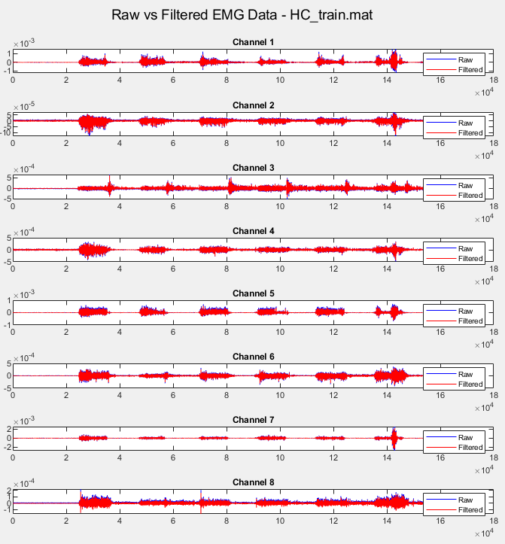
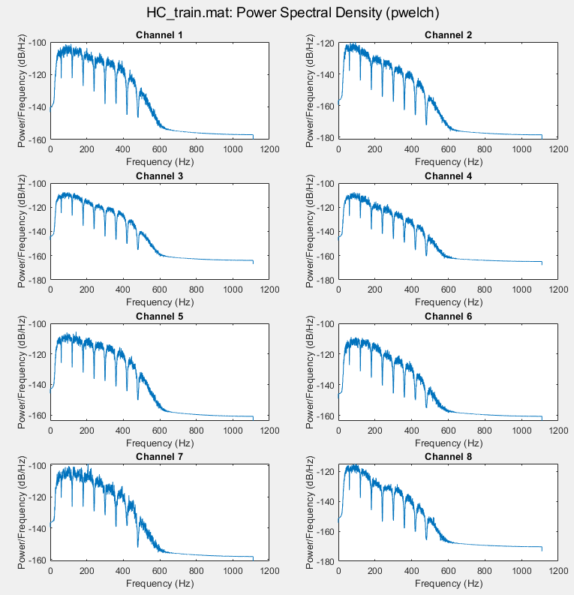
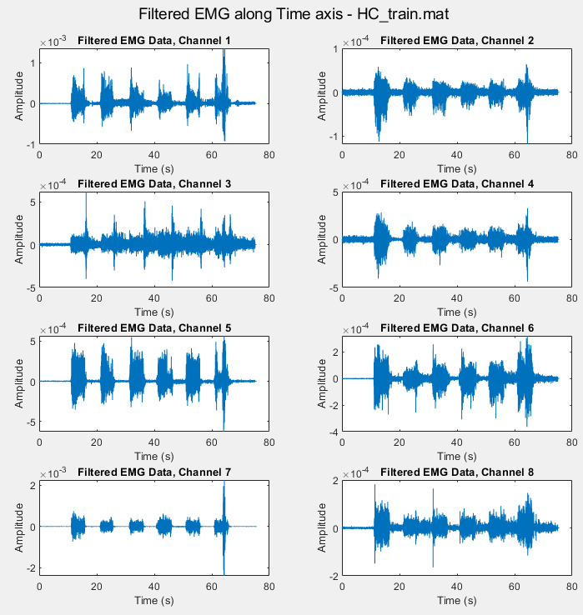
Representative Filtered Data for Single Posture (Hand Close)
Raw vs. Filtered EMG Data
Power vs. Frequency
(filtered EMG data)
Amplitude vs. Time
(filtered EMG data)
Notes:
Raw data
Filtered Data
Bonus:
Freq. vs. Power plot of filtered data for single posture (e.g., pwelch plot)
Filtered EMG data along time axis for each channel for a single posture, e.g., HO_train

Slide 8
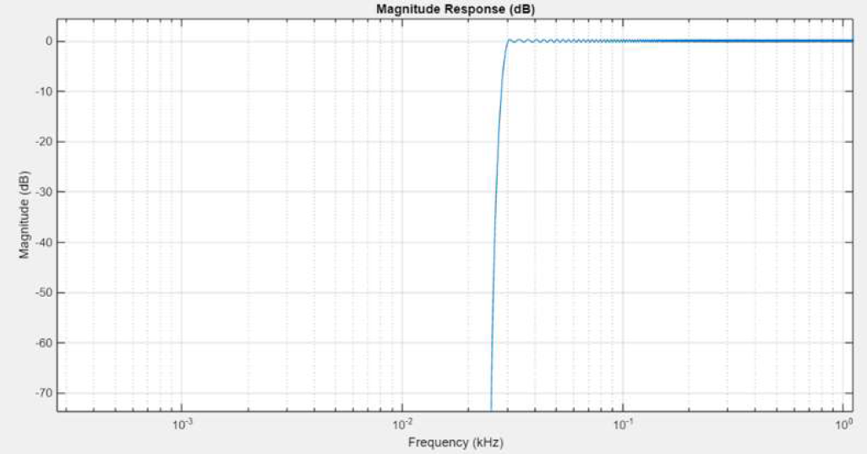
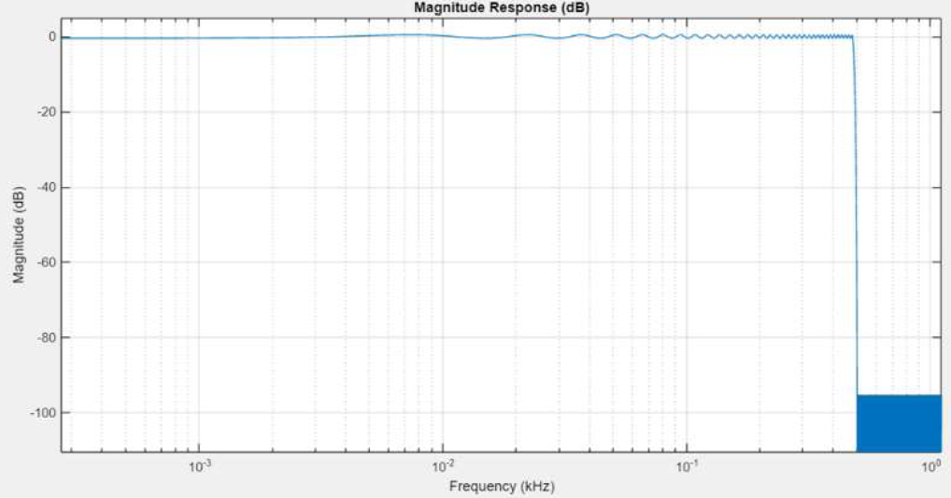
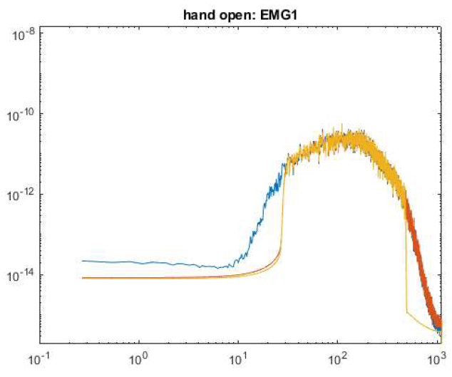
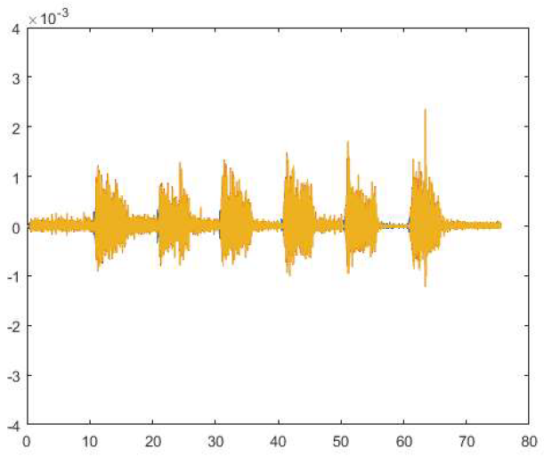
Signal Processing – Filter Design (final method)
High-Pass Filter Response
Low-Pass Filter Response
MATLAB designfilt() function and
Finite Impulse Response (FIR) filter
Filter Design w/ cutoff frequencies
High-pass: 30Hz cutoff
Passband = 30 Hz
Stopband: 25 Hz
Stopband Attenuation: 95 db
Passband Ripple: 1 db
Low-pass: 480Hz cutoff
Passband = 480 Hz
Stopband: 500 Hz
Stopband Attenuation: 95 db
Passband Ripple: 1 db
Bode Plot and Filtered vs. Raw Data
for a Single Posture
Bode Plot
Raw vs. Filtered EMG data
(for Single Posture)
Blue = Raw Data; Red = Data post-HPF; Yellow = Filtered Data post- HPF and LFP
Notes:
Filter Design w/ cutoff frequencies
High pass: 30Hz to remove motion artefact
Low Pass: 480Hz to bandlimit to ~500Hz
Notch
MATLAB designfilt() function
Passband:
Stopband (cut-off)
Stopband Attenuation: 95 db
Passband Ripple: 1 db
Blue = raw
Red = post-HP
Yellow = post-HP and LP

Slide 9
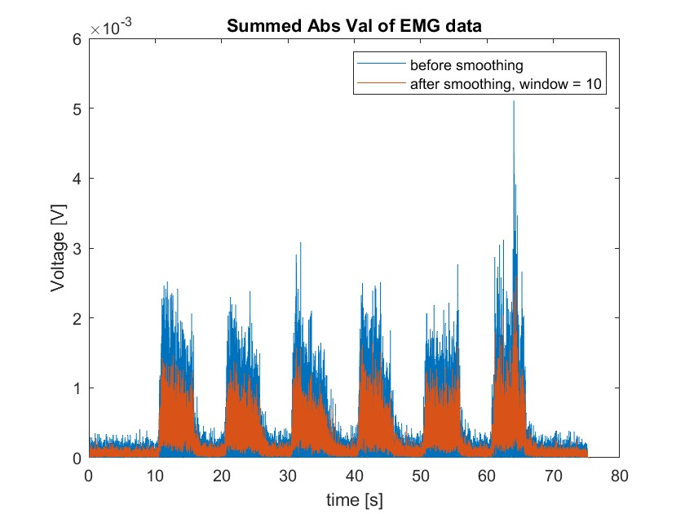
Signal Processing – Quiescent Data Removal
Matlab smoothdata()
Use std() and visual validation to define "off" threshold
Σ(abs(FilteredEMG))
Quiescence Removal Key Points
Data is smoother with a larger smoothing window, or interval over which the moving average is taken
LDA results improve with optimizing quiescence removal
Notes:
Input Data
Signal Processing Steps
“Off” section removal method
Quiescent data removal method
Output Data
%% Filter Design plotting w/ cutoff frequencies
Fs = allData_cellArray{1, 2}.posture.Fs(1); % 2.2222e+03 Hz
% High Pass Filter - 30Hz to remove motion artefact - choose a multiple of 60Hz
[b_hp, a_hp] = butter(4, 30/(Fs/2), 'high'); % 4th order butterworth
% Low Pass Filter - 480Hz to bandlimit to around 500Hz - choose a multiple of 60Hz
[b_lp, a_lp] = butter(4, 480/(Fs/2), 'low'); % 4th order butterworth
% Notch Filter centered at 60Hz
f0 = 60; % Notch frequency
Q = 35; % Quality factor, q = ω0/bw where ω0 is the frequency to remove from the signal
[b_notch, a_notch] = iirnotch(f0/(Fs/2), f0/(Fs/2)/Q); % 2nd order infinite impulse response (IIR) notch filter
% Comb Filter centered at 60Hz and its harmonics (120Hz, 180Hz, 240Hz, 300Hz, 360Hz, 420Hz) up to the passband (480 Hz)
f0 = 60; % Notch frequency
bw = f0 / Q; % Bandwidth, bw = (fo/(fs/2))/q;
n_harmonics = floor((Fs / 2) / f0); % Number of harmonics within Nyquist frequency
[b_comb, a_comb] = iircomb(floor(Fs/f0), bw/(Fs/2), 'notch'); % Design comb filter
% Define quiescent threshold
quietThresh = mean(on_data(1,:)) + (0.5*std(on_data(1,:))); % Adjust multiplier as needed
% Initialize array to store 'active' data, where the muscle is not quiescent
active_data = [];
active_time = [];
% Define the bin size for iteration, could be the same as used for 'off' detection
binSize = 1.5e-3; % 1.5 ms in seconds
binSamples = round(binSize * Fs); % Convert bin size to number of samples
% Loop to identify and store 'active' data
for i = 1:binSamples:length(on_data(1,:)) - binSamples
segment = on_data(1, i:i+binSamples-1);
% Check if the segment's activity exceeds the quiescent threshold
if max(abs(segment)) > quietThresh
active_data = [active_data, segment];
active_time = [active_time, on_data_Time(1, i:i+binSamples-1)];
end
end
% Plot the 'active' data
figure;
plot(active_time, active_data, 'r-');
title('HO train, Sensor 1: EMG Data with Quiescent Data Removed');
xlabel('Time (s)');
ylabel('Amplitude');
ylim([-4e-4 4e-4]);
xlim([0, on_data_Time(1,end)]);
…
%% 4) Graph Mean Absolute Value, Slope Sign Change, Zero Crossings, Waveform Length value for the 50ms bin size and 2 EMG sensors in one posture ('HO_train.mat')
% Prepare the data for feature extraction
% Set the bin size to 50ms
binSize = 0.050; % 50 ms in seconds
binSamples = round(binSize * Fs); % Convert bin size to number of samples per bin
% Initialize feature matrices
MAV = cell(1, 2);
SSC = cell(1, 2);
ZC = cell(1, 2);
WL = cell(1, 2);
% Define active data for HO train, sensor 1 and sensor 2
active_data_s1s2 = {active_data, active_data_2};
% Loop over the 'active' data in bins to calculate features for each sensor
for sensor_idx = 1:2
active_data_sensor = active_data_s1s2{sensor_idx};
% Determine the number of full bins we can calculate
numBins = floor(length(active_data_sensor) / binSamples);
% Initialize the feature arrays for each sensor based on the number of bins
MAV{sensor_idx} = zeros(1, numBins);
SSC{sensor_idx} = zeros(1, numBins);
ZC{sensor_idx} = zeros(1, numBins);
WL{sensor_idx} = zeros(1, numBins);
for bin = 1:numBins
startIdx = (bin - 1) * binSamples + 1;
endIdx = bin * binSamples;
binData = active_data_sensor(startIdx:endIdx);
% Calculate features for each bin
MAV{sensor_idx}(bin) = mean(abs(binData));
SSC{sensor_idx}(bin) = sum(diff(sign(diff(binData)))~=0);
ZC{sensor_idx}(bin) = sum(diff(sign(binData))~=0);
WL{sensor_idx}(bin) = sum(abs(diff(binData)));
end
end
% Calculate feature_time based on the actual number of bins calculated
feature_time = ((1:numBins) - 0.5) * binSize; % Center time in each bin
% Verify the number of bins and adjust feature_time accordingly - test for single feature (MAV)
numBins = min([length(MAV{1}), length(MAV{2})]); % Use the smaller number of bins if different
feature_time = ((1:numBins) - 0.5) * binSize;
% Trim the feature vectors if necessary
MAV{1} = MAV{1}(1:numBins);
MAV{2} = MAV{2}(1:numBins);
% Debugging prints
disp(['Length of feature_time: ', num2str(length(feature_time))]);
disp(['Length of MAV{1}: ', num2str(length(MAV{1}))]);
disp(['Length of MAV{2}: ', num2str(length(MAV{2}))]);
% Now plot the features with the corrected lengths
figure;
title('Feature Extraction for HO_train');
% Plot Mean Absolute Value for Sensor 1 and Sensor 2
hold on;
plot(feature_time, MAV{1}, 'r');
plot(feature_time, MAV{2}, 'b');
title('Mean Absolute Value (MAV)');
xlabel('Time (s)');
ylabel('MAV');
legend('Sensor 1', 'Sensor 2');
hold off;
%% Verify the number of bins and adjust feature_time accordingly for all features
% Determine the smallest number of bins across all sensors and features
numBins = min([
length(MAV{1}), length(MAV{2}),
length(SSC{1}), length(SSC{2}),
length(ZC{1}), length(ZC{2}),
length(WL{1}), length(WL{2})
]);
% Adjust feature vectors to have the same number of elements
MAV{1} = MAV{1}(1:numBins);
MAV{2} = MAV{2}(1:numBins);
SSC{1} = SSC{1}(1:numBins);
SSC{2} = SSC{2}(1:numBins);
ZC{1} = ZC{1}(1:numBins);
ZC{2} = ZC{2}(1:numBins);
WL{1} = WL{1}(1:numBins);
WL{2} = WL{2}(1:numBins);
% Adjust feature_time
feature_time = ((1:numBins) - 0.5) * binSize;
%% Plot extracted features
figure;
t = tiledlayout(4,1);
title(t,'Feature Extraction for HO_train');
% Plot Mean Absolute Value
nexttile;
hold on;
plot(feature_time, MAV{1}, 'r', 'DisplayName', 'Sensor 1 MAV');
plot(feature_time, MAV{2}, 'b', 'DisplayName', 'Sensor 2 MAV');
title('Mean Absolute Value (MAV)');
xlabel('Time (s)');
ylabel('MAV');
legend;
hold off;
% Plot Slope Sign Changes
nexttile;
hold on;
plot(feature_time, SSC{1}, 'r', 'DisplayName', 'Sensor 1 SSC');
plot(feature_time, SSC{2}, 'b', 'DisplayName', 'Sensor 2 SSC');
title('Slope Sign Changes (SSC)');
xlabel('Time (s)');
ylabel('SSC');
legend;
hold off;
% Plot Zero Crossings
nexttile;
hold on;
plot(feature_time, ZC{1}, 'r', 'DisplayName', 'Sensor 1 ZC');
plot(feature_time, ZC{2}, 'b', 'DisplayName', 'Sensor 2 ZC');
title('Zero Crossings (ZC)');
xlabel('Time (s)');
ylabel('ZC');
legend;
hold off;
% Plot Waveform Length
nexttile;
hold on;
plot(feature_time, WL{1}, 'r', 'DisplayName', 'Sensor 1 WL');
plot(feature_time, WL{2}, 'b', 'DisplayName', 'Sensor 2 WL');
title('Waveform Length (WL)');
xlabel('Time (s)');
ylabel('WL');
legend;
hold off;

Slide 10
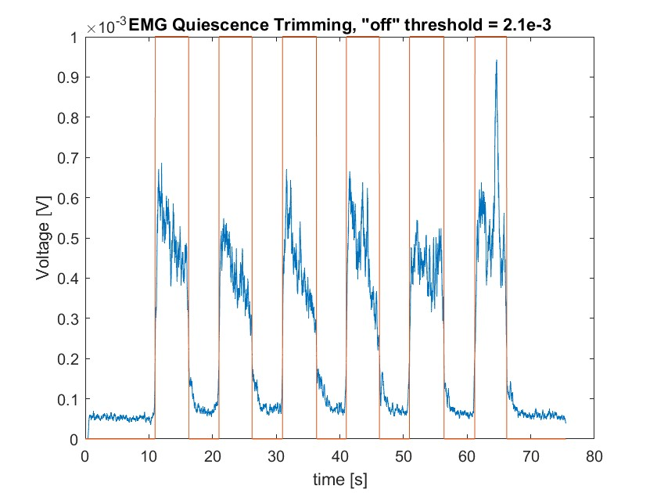
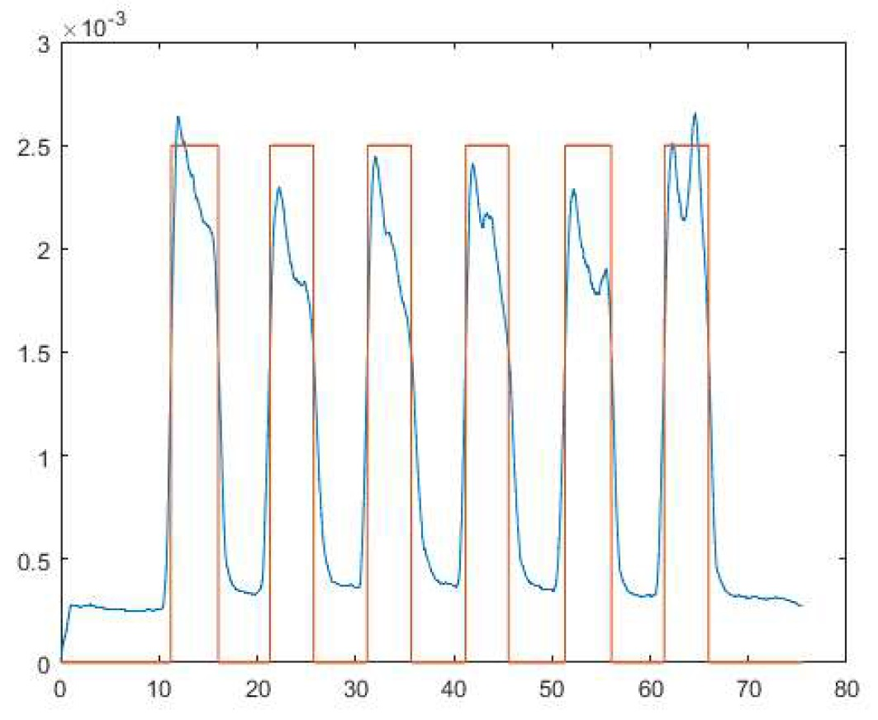
“On” v. "Off" Data (Quiescent Data Removal)
Initial "On"/"Off", Sum abs(Postures)
Intermediate "On"/"Off" Separation
EMG Quiescence Trimming, "off" threshold = 1.5e-3
Voltage [V]
time [s]
Notes:
Filtered Data with “Off” sections removed
Filtered data with quiescent data removed

Slide 11
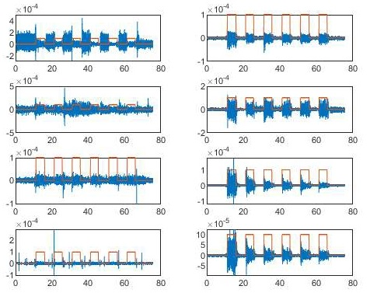
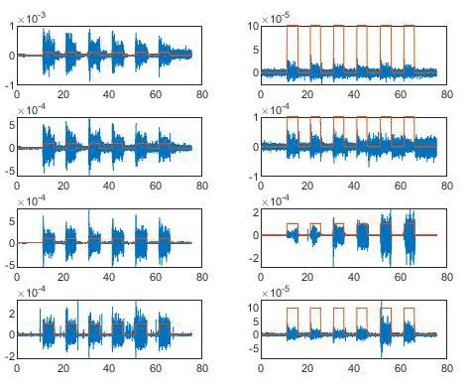
Example Plots – “On” Data Method: Summing All Data
WF Posture, Quiescence Removal
WE Posture, Quiescence Removal
Voltage [V]
Voltage [V]
time [s]
time [s]
time [s]
time [s]

Slide 12
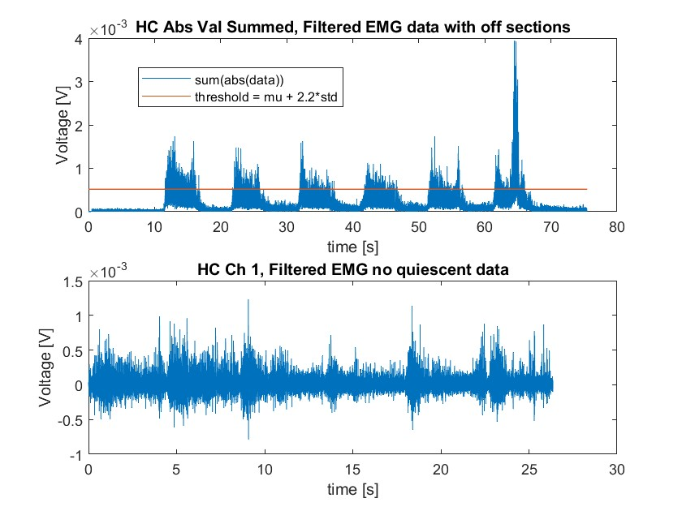
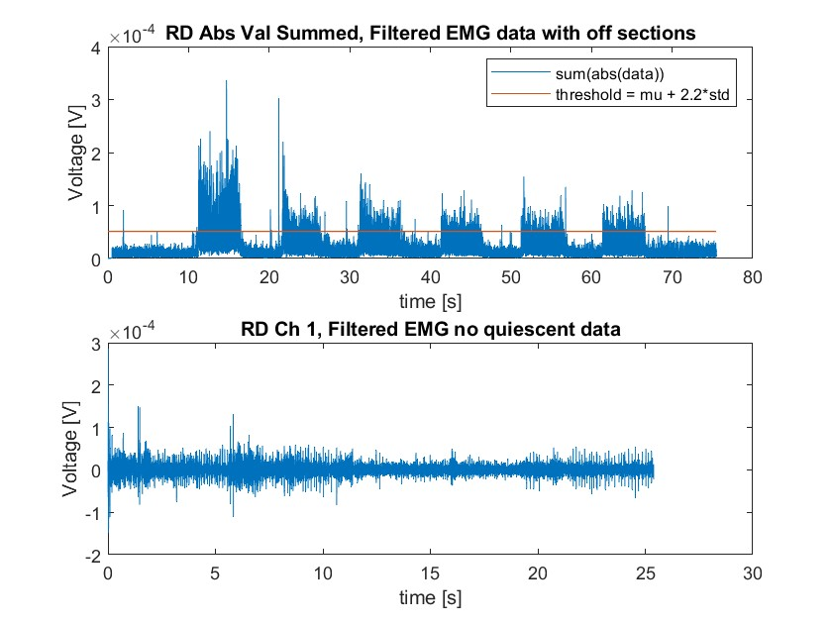
Example Plots – “On” Data Method: Posture Specific Threshold

Slide 13
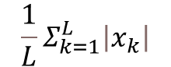
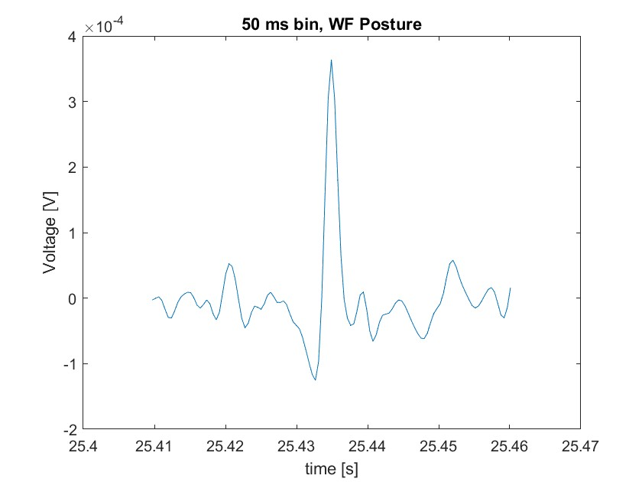
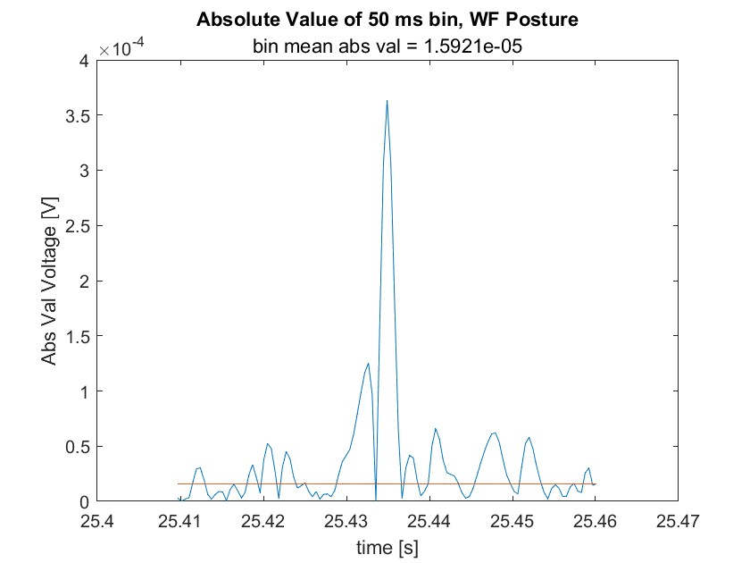
Feature Extraction Methods
– Mean Absolute Value (MAV)
Input Data = Binned, Filtered, Quiescence Removed EMG Data
MAV = , L = number of bins, k = indexing number within bin
bins
abs()
Notes:
%% 4) Graph Mean Absolute Value, Slope Sign Change, Zero Crossings, Waveform Length value for the 50ms bin size and 2 EMG sensors in one posture ('HO_train.mat')
% Prepare the data for feature extraction
% Set the bin size to 50ms
binSize = 0.050; % 50 ms in seconds
binSamples = round(binSize * Fs); % Convert bin size to number of samples per bin
% Initialize feature matrices
MAV = cell(1, 2);
SSC = cell(1, 2);
ZC = cell(1, 2);
WL = cell(1, 2);
% Define active data for HO train, sensor 1 and sensor 2
active_data_s1s2 = {active_data, active_data_2};
% Loop over the 'active' data in bins to calculate features for each sensor
for sensor_idx = 1:2
active_data_sensor = active_data_s1s2{sensor_idx};
% Determine the number of full bins we can calculate
numBins = floor(length(active_data_sensor) / binSamples);
% Initialize the feature arrays for each sensor based on the number of bins
MAV{sensor_idx} = zeros(1, numBins);
SSC{sensor_idx} = zeros(1, numBins);
ZC{sensor_idx} = zeros(1, numBins);
WL{sensor_idx} = zeros(1, numBins);
for bin = 1:numBins
startIdx = (bin - 1) * binSamples + 1;
endIdx = bin * binSamples;
binData = active_data_sensor(startIdx:endIdx);
% Calculate features for each bin
MAV{sensor_idx}(bin) = mean(abs(binData));
SSC{sensor_idx}(bin) = sum(diff(sign(diff(binData)))~=0);
ZC{sensor_idx}(bin) = sum(diff(sign(binData))~=0);
WL{sensor_idx}(bin) = sum(abs(diff(binData)));
end
end
% Calculate feature_time based on the actual number of bins calculated
feature_time = ((1:numBins) - 0.5) * binSize; % Center time in each bin
% Verify the number of bins and adjust feature_time accordingly - test for single feature (MAV)
numBins = min([length(MAV{1}), length(MAV{2})]); % Use the smaller number of bins if different
feature_time = ((1:numBins) - 0.5) * binSize;
% Trim the feature vectors if necessary
MAV{1} = MAV{1}(1:numBins);
MAV{2} = MAV{2}(1:numBins);
% Debugging prints
disp(['Length of feature_time: ', num2str(length(feature_time))]);
disp(['Length of MAV{1}: ', num2str(length(MAV{1}))]);
disp(['Length of MAV{2}: ', num2str(length(MAV{2}))]);
% Now plot the features with the corrected lengths
figure;
title('Feature Extraction for HO_train');
% Plot Mean Absolute Value for Sensor 1 and Sensor 2
hold on;
plot(feature_time, MAV{1}, 'r');
plot(feature_time, MAV{2}, 'b');
title('Mean Absolute Value (MAV)');
xlabel('Time (s)');
ylabel('MAV');
legend('Sensor 1', 'Sensor 2');
hold off;
%% Verify the number of bins and adjust feature_time accordingly for all features
% Determine the smallest number of bins across all sensors and features
numBins = min([
length(MAV{1}), length(MAV{2}),
length(SSC{1}), length(SSC{2}),
length(ZC{1}), length(ZC{2}),
length(WL{1}), length(WL{2})
]);
% Adjust feature vectors to have the same number of elements
MAV{1} = MAV{1}(1:numBins);
MAV{2} = MAV{2}(1:numBins);
SSC{1} = SSC{1}(1:numBins);
SSC{2} = SSC{2}(1:numBins);
ZC{1} = ZC{1}(1:numBins);
ZC{2} = ZC{2}(1:numBins);
WL{1} = WL{1}(1:numBins);
WL{2} = WL{2}(1:numBins);
% Adjust feature_time
feature_time = ((1:numBins) - 0.5) * binSize;
%% Plot extracted features
figure;
t = tiledlayout(4,1);
title(t,'Feature Extraction for HO_train');
% Plot Mean Absolute Value
nexttile;
hold on;
plot(feature_time, MAV{1}, 'r', 'DisplayName', 'Sensor 1 MAV');
plot(feature_time, MAV{2}, 'b', 'DisplayName', 'Sensor 2 MAV');
title('Mean Absolute Value (MAV)');
xlabel('Time (s)');
ylabel('MAV');
legend;
hold off;
% Plot Slope Sign Changes
nexttile;
hold on;
plot(feature_time, SSC{1}, 'r', 'DisplayName', 'Sensor 1 SSC');
plot(feature_time, SSC{2}, 'b', 'DisplayName', 'Sensor 2 SSC');
title('Slope Sign Changes (SSC)');
xlabel('Time (s)');
ylabel('SSC');
legend;
hold off;
% Plot Zero Crossings
nexttile;
hold on;
plot(feature_time, ZC{1}, 'r', 'DisplayName', 'Sensor 1 ZC');
plot(feature_time, ZC{2}, 'b', 'DisplayName', 'Sensor 2 ZC');
title('Zero Crossings (ZC)');
xlabel('Time (s)');
ylabel('ZC');
legend;
hold off;
% Plot Waveform Length
nexttile;
hold on;
plot(feature_time, WL{1}, 'r', 'DisplayName', 'Sensor 1 WL');
plot(feature_time, WL{2}, 'b', 'DisplayName', 'Sensor 2 WL');
title('Waveform Length (WL)');
xlabel('Time (s)');
ylabel('WL');
legend;
hold off;

Slide 14
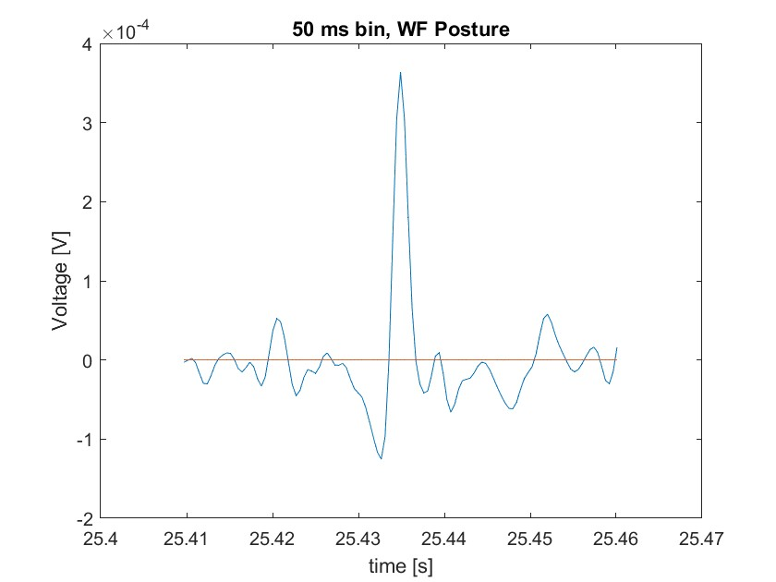
Feature Extraction Methods
-Zero Crossings (ZC)
Input Data = Binned, Filtered, Quiescence Removed EMG Data
ZC = Number of times for which x_{k} * x_{k+1} < 0
|x_{k} – x_{k+1}| ≥ ε , ε = threshold to eliminate noise
PseudoCode:
for i = 1 : (length of bin – 1)
if i * (i+1) < 0
if |i - (i+1)| ≥ ε
increase count of ZC by 1
end
end
end
Notes:
%% 4) Graph Mean Absolute Value, Slope Sign Change, Zero Crossings, Waveform Length value for the 50ms bin size and 2 EMG sensors in one posture ('HO_train.mat')
% Prepare the data for feature extraction
% Set the bin size to 50ms
binSize = 0.050; % 50 ms in seconds
binSamples = round(binSize * Fs); % Convert bin size to number of samples per bin
% Initialize feature matrices
MAV = cell(1, 2);
SSC = cell(1, 2);
ZC = cell(1, 2);
WL = cell(1, 2);
% Define active data for HO train, sensor 1 and sensor 2
active_data_s1s2 = {active_data, active_data_2};
% Loop over the 'active' data in bins to calculate features for each sensor
for sensor_idx = 1:2
active_data_sensor = active_data_s1s2{sensor_idx};
% Determine the number of full bins we can calculate
numBins = floor(length(active_data_sensor) / binSamples);
% Initialize the feature arrays for each sensor based on the number of bins
MAV{sensor_idx} = zeros(1, numBins);
SSC{sensor_idx} = zeros(1, numBins);
ZC{sensor_idx} = zeros(1, numBins);
WL{sensor_idx} = zeros(1, numBins);
for bin = 1:numBins
startIdx = (bin - 1) * binSamples + 1;
endIdx = bin * binSamples;
binData = active_data_sensor(startIdx:endIdx);
% Calculate features for each bin
MAV{sensor_idx}(bin) = mean(abs(binData));
SSC{sensor_idx}(bin) = sum(diff(sign(diff(binData)))~=0);
ZC{sensor_idx}(bin) = sum(diff(sign(binData))~=0);
WL{sensor_idx}(bin) = sum(abs(diff(binData)));
end
end
% Calculate feature_time based on the actual number of bins calculated
feature_time = ((1:numBins) - 0.5) * binSize; % Center time in each bin
% Verify the number of bins and adjust feature_time accordingly - test for single feature (MAV)
numBins = min([length(MAV{1}), length(MAV{2})]); % Use the smaller number of bins if different
feature_time = ((1:numBins) - 0.5) * binSize;
% Trim the feature vectors if necessary
MAV{1} = MAV{1}(1:numBins);
MAV{2} = MAV{2}(1:numBins);
% Debugging prints
disp(['Length of feature_time: ', num2str(length(feature_time))]);
disp(['Length of MAV{1}: ', num2str(length(MAV{1}))]);
disp(['Length of MAV{2}: ', num2str(length(MAV{2}))]);
% Now plot the features with the corrected lengths
figure;
title('Feature Extraction for HO_train');
% Plot Mean Absolute Value for Sensor 1 and Sensor 2
hold on;
plot(feature_time, MAV{1}, 'r');
plot(feature_time, MAV{2}, 'b');
title('Mean Absolute Value (MAV)');
xlabel('Time (s)');
ylabel('MAV');
legend('Sensor 1', 'Sensor 2');
hold off;
%% Verify the number of bins and adjust feature_time accordingly for all features
% Determine the smallest number of bins across all sensors and features
numBins = min([
length(MAV{1}), length(MAV{2}),
length(SSC{1}), length(SSC{2}),
length(ZC{1}), length(ZC{2}),
length(WL{1}), length(WL{2})
]);
% Adjust feature vectors to have the same number of elements
MAV{1} = MAV{1}(1:numBins);
MAV{2} = MAV{2}(1:numBins);
SSC{1} = SSC{1}(1:numBins);
SSC{2} = SSC{2}(1:numBins);
ZC{1} = ZC{1}(1:numBins);
ZC{2} = ZC{2}(1:numBins);
WL{1} = WL{1}(1:numBins);
WL{2} = WL{2}(1:numBins);
% Adjust feature_time
feature_time = ((1:numBins) - 0.5) * binSize;
%% Plot extracted features
figure;
t = tiledlayout(4,1);
title(t,'Feature Extraction for HO_train');
% Plot Mean Absolute Value
nexttile;
hold on;
plot(feature_time, MAV{1}, 'r', 'DisplayName', 'Sensor 1 MAV');
plot(feature_time, MAV{2}, 'b', 'DisplayName', 'Sensor 2 MAV');
title('Mean Absolute Value (MAV)');
xlabel('Time (s)');
ylabel('MAV');
legend;
hold off;
% Plot Slope Sign Changes
nexttile;
hold on;
plot(feature_time, SSC{1}, 'r', 'DisplayName', 'Sensor 1 SSC');
plot(feature_time, SSC{2}, 'b', 'DisplayName', 'Sensor 2 SSC');
title('Slope Sign Changes (SSC)');
xlabel('Time (s)');
ylabel('SSC');
legend;
hold off;
% Plot Zero Crossings
nexttile;
hold on;
plot(feature_time, ZC{1}, 'r', 'DisplayName', 'Sensor 1 ZC');
plot(feature_time, ZC{2}, 'b', 'DisplayName', 'Sensor 2 ZC');
title('Zero Crossings (ZC)');
xlabel('Time (s)');
ylabel('ZC');
legend;
hold off;
% Plot Waveform Length
nexttile;
hold on;
plot(feature_time, WL{1}, 'r', 'DisplayName', 'Sensor 1 WL');
plot(feature_time, WL{2}, 'b', 'DisplayName', 'Sensor 2 WL');
title('Waveform Length (WL)');
xlabel('Time (s)');
ylabel('WL');
legend;
hold off;

Slide 15
Feature Extraction Methods
- Slope Sign Change (SSC)
Input Data = Binned, Filtered, Quiescence Removed EMG Data
SSC = Number of times the sign of the slope changes within the bin
= Number of local maxima and minima, ε = threshold to eliminate noise
PseudoCode:
for i = 1 : (length of bin – 1)
dy1 = (i + 1) - i;
dy2 = (i + 2) - (i + 1);
if dy1 * dy2 < 0
if |dy1 - dy2| ≥ ε
increase count of SSC by 1
end
end
end
Notes:
%% 4) Graph Mean Absolute Value, Slope Sign Change, Zero Crossings, Waveform Length value for the 50ms bin size and 2 EMG sensors in one posture ('HO_train.mat')
% Prepare the data for feature extraction
% Set the bin size to 50ms
binSize = 0.050; % 50 ms in seconds
binSamples = round(binSize * Fs); % Convert bin size to number of samples per bin
% Initialize feature matrices
MAV = cell(1, 2);
SSC = cell(1, 2);
ZC = cell(1, 2);
WL = cell(1, 2);
% Define active data for HO train, sensor 1 and sensor 2
active_data_s1s2 = {active_data, active_data_2};
% Loop over the 'active' data in bins to calculate features for each sensor
for sensor_idx = 1:2
active_data_sensor = active_data_s1s2{sensor_idx};
% Determine the number of full bins we can calculate
numBins = floor(length(active_data_sensor) / binSamples);
% Initialize the feature arrays for each sensor based on the number of bins
MAV{sensor_idx} = zeros(1, numBins);
SSC{sensor_idx} = zeros(1, numBins);
ZC{sensor_idx} = zeros(1, numBins);
WL{sensor_idx} = zeros(1, numBins);
for bin = 1:numBins
startIdx = (bin - 1) * binSamples + 1;
endIdx = bin * binSamples;
binData = active_data_sensor(startIdx:endIdx);
% Calculate features for each bin
MAV{sensor_idx}(bin) = mean(abs(binData));
SSC{sensor_idx}(bin) = sum(diff(sign(diff(binData)))~=0);
ZC{sensor_idx}(bin) = sum(diff(sign(binData))~=0);
WL{sensor_idx}(bin) = sum(abs(diff(binData)));
end
end
% Calculate feature_time based on the actual number of bins calculated
feature_time = ((1:numBins) - 0.5) * binSize; % Center time in each bin
% Verify the number of bins and adjust feature_time accordingly - test for single feature (MAV)
numBins = min([length(MAV{1}), length(MAV{2})]); % Use the smaller number of bins if different
feature_time = ((1:numBins) - 0.5) * binSize;
% Trim the feature vectors if necessary
MAV{1} = MAV{1}(1:numBins);
MAV{2} = MAV{2}(1:numBins);
% Debugging prints
disp(['Length of feature_time: ', num2str(length(feature_time))]);
disp(['Length of MAV{1}: ', num2str(length(MAV{1}))]);
disp(['Length of MAV{2}: ', num2str(length(MAV{2}))]);
% Now plot the features with the corrected lengths
figure;
title('Feature Extraction for HO_train');
% Plot Mean Absolute Value for Sensor 1 and Sensor 2
hold on;
plot(feature_time, MAV{1}, 'r');
plot(feature_time, MAV{2}, 'b');
title('Mean Absolute Value (MAV)');
xlabel('Time (s)');
ylabel('MAV');
legend('Sensor 1', 'Sensor 2');
hold off;
%% Verify the number of bins and adjust feature_time accordingly for all features
% Determine the smallest number of bins across all sensors and features
numBins = min([
length(MAV{1}), length(MAV{2}),
length(SSC{1}), length(SSC{2}),
length(ZC{1}), length(ZC{2}),
length(WL{1}), length(WL{2})
]);
% Adjust feature vectors to have the same number of elements
MAV{1} = MAV{1}(1:numBins);
MAV{2} = MAV{2}(1:numBins);
SSC{1} = SSC{1}(1:numBins);
SSC{2} = SSC{2}(1:numBins);
ZC{1} = ZC{1}(1:numBins);
ZC{2} = ZC{2}(1:numBins);
WL{1} = WL{1}(1:numBins);
WL{2} = WL{2}(1:numBins);
% Adjust feature_time
feature_time = ((1:numBins) - 0.5) * binSize;
%% Plot extracted features
figure;
t = tiledlayout(4,1);
title(t,'Feature Extraction for HO_train');
% Plot Mean Absolute Value
nexttile;
hold on;
plot(feature_time, MAV{1}, 'r', 'DisplayName', 'Sensor 1 MAV');
plot(feature_time, MAV{2}, 'b', 'DisplayName', 'Sensor 2 MAV');
title('Mean Absolute Value (MAV)');
xlabel('Time (s)');
ylabel('MAV');
legend;
hold off;
% Plot Slope Sign Changes
nexttile;
hold on;
plot(feature_time, SSC{1}, 'r', 'DisplayName', 'Sensor 1 SSC');
plot(feature_time, SSC{2}, 'b', 'DisplayName', 'Sensor 2 SSC');
title('Slope Sign Changes (SSC)');
xlabel('Time (s)');
ylabel('SSC');
legend;
hold off;
% Plot Zero Crossings
nexttile;
hold on;
plot(feature_time, ZC{1}, 'r', 'DisplayName', 'Sensor 1 ZC');
plot(feature_time, ZC{2}, 'b', 'DisplayName', 'Sensor 2 ZC');
title('Zero Crossings (ZC)');
xlabel('Time (s)');
ylabel('ZC');
legend;
hold off;
% Plot Waveform Length
nexttile;
hold on;
plot(feature_time, WL{1}, 'r', 'DisplayName', 'Sensor 1 WL');
plot(feature_time, WL{2}, 'b', 'DisplayName', 'Sensor 2 WL');
title('Waveform Length (WL)');
xlabel('Time (s)');
ylabel('WL');
legend;
hold off;

Slide 16
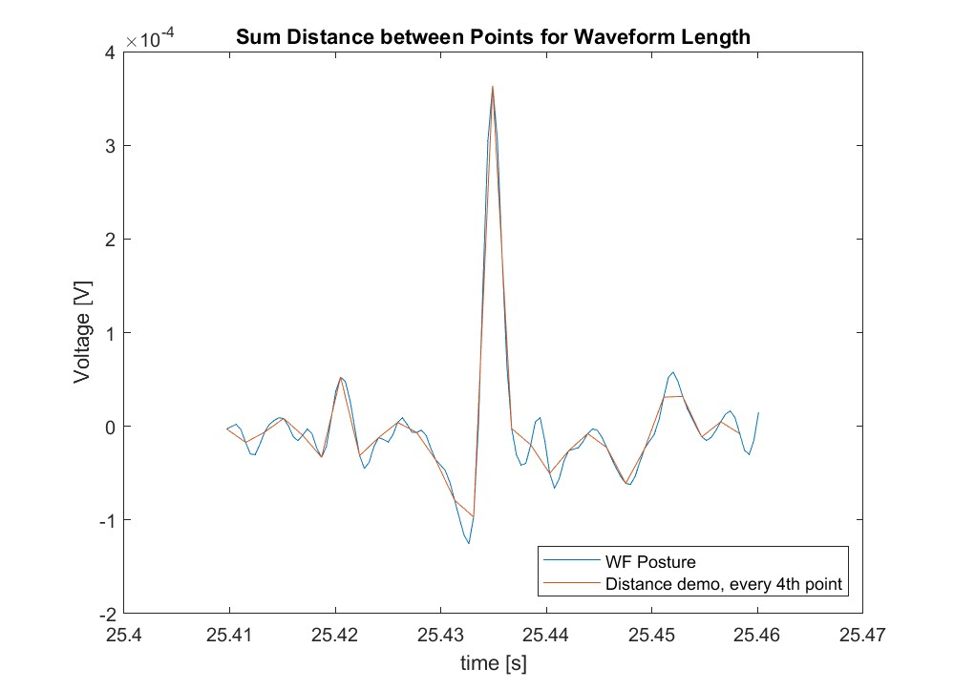
Feature Extraction Methods
- Waveform Length (WL)
EuclDist (x_{i} +1) to (x_{i})
Σ(EuclDist(x_{i}))
Waveform Length,
each bin
Notes:
%% 4) Graph Mean Absolute Value, Slope Sign Change, Zero Crossings, Waveform Length value for the 50ms bin size and 2 EMG sensors in one posture ('HO_train.mat')
% Prepare the data for feature extraction
% Set the bin size to 50ms
binSize = 0.050; % 50 ms in seconds
binSamples = round(binSize * Fs); % Convert bin size to number of samples per bin
% Initialize feature matrices
MAV = cell(1, 2);
SSC = cell(1, 2);
ZC = cell(1, 2);
WL = cell(1, 2);
% Define active data for HO train, sensor 1 and sensor 2
active_data_s1s2 = {active_data, active_data_2};
% Loop over the 'active' data in bins to calculate features for each sensor
for sensor_idx = 1:2
active_data_sensor = active_data_s1s2{sensor_idx};
% Determine the number of full bins we can calculate
numBins = floor(length(active_data_sensor) / binSamples);
% Initialize the feature arrays for each sensor based on the number of bins
MAV{sensor_idx} = zeros(1, numBins);
SSC{sensor_idx} = zeros(1, numBins);
ZC{sensor_idx} = zeros(1, numBins);
WL{sensor_idx} = zeros(1, numBins);
for bin = 1:numBins
startIdx = (bin - 1) * binSamples + 1;
endIdx = bin * binSamples;
binData = active_data_sensor(startIdx:endIdx);
% Calculate features for each bin
MAV{sensor_idx}(bin) = mean(abs(binData));
SSC{sensor_idx}(bin) = sum(diff(sign(diff(binData)))~=0);
ZC{sensor_idx}(bin) = sum(diff(sign(binData))~=0);
WL{sensor_idx}(bin) = sum(abs(diff(binData)));
end
end
% Calculate feature_time based on the actual number of bins calculated
feature_time = ((1:numBins) - 0.5) * binSize; % Center time in each bin
% Verify the number of bins and adjust feature_time accordingly - test for single feature (MAV)
numBins = min([length(MAV{1}), length(MAV{2})]); % Use the smaller number of bins if different
feature_time = ((1:numBins) - 0.5) * binSize;
% Trim the feature vectors if necessary
MAV{1} = MAV{1}(1:numBins);
MAV{2} = MAV{2}(1:numBins);
% Debugging prints
disp(['Length of feature_time: ', num2str(length(feature_time))]);
disp(['Length of MAV{1}: ', num2str(length(MAV{1}))]);
disp(['Length of MAV{2}: ', num2str(length(MAV{2}))]);
% Now plot the features with the corrected lengths
figure;
title('Feature Extraction for HO_train');
% Plot Mean Absolute Value for Sensor 1 and Sensor 2
hold on;
plot(feature_time, MAV{1}, 'r');
plot(feature_time, MAV{2}, 'b');
title('Mean Absolute Value (MAV)');
xlabel('Time (s)');
ylabel('MAV');
legend('Sensor 1', 'Sensor 2');
hold off;
%% Verify the number of bins and adjust feature_time accordingly for all features
% Determine the smallest number of bins across all sensors and features
numBins = min([
length(MAV{1}), length(MAV{2}),
length(SSC{1}), length(SSC{2}),
length(ZC{1}), length(ZC{2}),
length(WL{1}), length(WL{2})
]);
% Adjust feature vectors to have the same number of elements
MAV{1} = MAV{1}(1:numBins);
MAV{2} = MAV{2}(1:numBins);
SSC{1} = SSC{1}(1:numBins);
SSC{2} = SSC{2}(1:numBins);
ZC{1} = ZC{1}(1:numBins);
ZC{2} = ZC{2}(1:numBins);
WL{1} = WL{1}(1:numBins);
WL{2} = WL{2}(1:numBins);
% Adjust feature_time
feature_time = ((1:numBins) - 0.5) * binSize;
%% Plot extracted features
figure;
t = tiledlayout(4,1);
title(t,'Feature Extraction for HO_train');
% Plot Mean Absolute Value
nexttile;
hold on;
plot(feature_time, MAV{1}, 'r', 'DisplayName', 'Sensor 1 MAV');
plot(feature_time, MAV{2}, 'b', 'DisplayName', 'Sensor 2 MAV');
title('Mean Absolute Value (MAV)');
xlabel('Time (s)');
ylabel('MAV');
legend;
hold off;
% Plot Slope Sign Changes
nexttile;
hold on;
plot(feature_time, SSC{1}, 'r', 'DisplayName', 'Sensor 1 SSC');
plot(feature_time, SSC{2}, 'b', 'DisplayName', 'Sensor 2 SSC');
title('Slope Sign Changes (SSC)');
xlabel('Time (s)');
ylabel('SSC');
legend;
hold off;
% Plot Zero Crossings
nexttile;
hold on;
plot(feature_time, ZC{1}, 'r', 'DisplayName', 'Sensor 1 ZC');
plot(feature_time, ZC{2}, 'b', 'DisplayName', 'Sensor 2 ZC');
title('Zero Crossings (ZC)');
xlabel('Time (s)');
ylabel('ZC');
legend;
hold off;
% Plot Waveform Length
nexttile;
hold on;
plot(feature_time, WL{1}, 'r', 'DisplayName', 'Sensor 1 WL');
plot(feature_time, WL{2}, 'b', 'DisplayName', 'Sensor 2 WL');
title('Waveform Length (WL)');
xlabel('Time (s)');
ylabel('WL');
legend;
hold off;

Slide 17
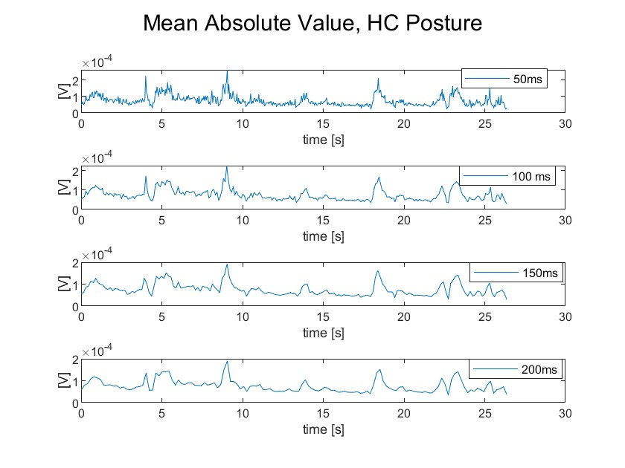
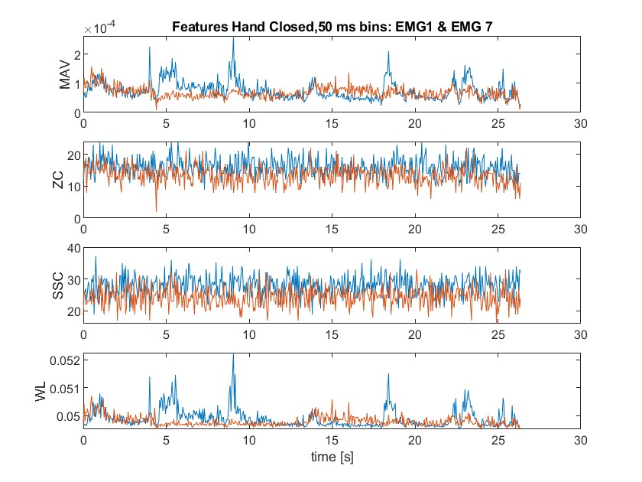
Feature Extraction Results - Example Plots
50 ms bins
Notes:
Graph of MAV for each bin size (50 ms, 100 ms, 150 ms, 200 ms) for 1 EMG sensor in one picture
Graph of MAV, SSC, ZC, WL for 50 ms bin size and 2 EMG sensors, one posture
Input Data = Filtered, Quiescence Removed EMG Data
Feature Extraction
Mean Absolute Value (MAV) for each bin size (50ms, 100ms, 150ms, 200ms)
Slope Sign Change (SSC)
Zero Crossings (ZC)
Waveform Length (WL)
Output Data

Slide 18
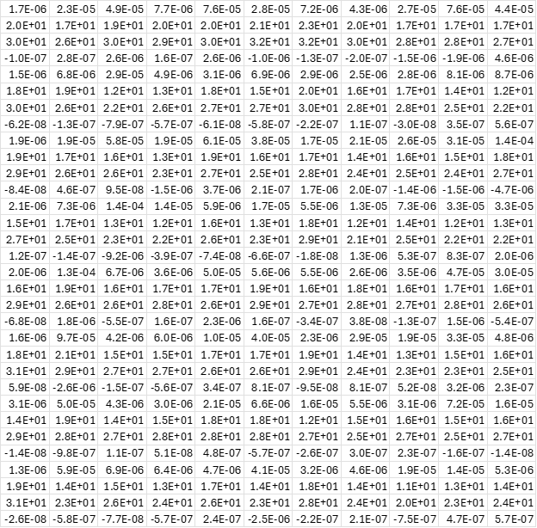
Mean Vectors
Notes:
These 11 vectors with 32 dimensions each represent the average "position" of each posture in 32 dimensional space.

Slide 19
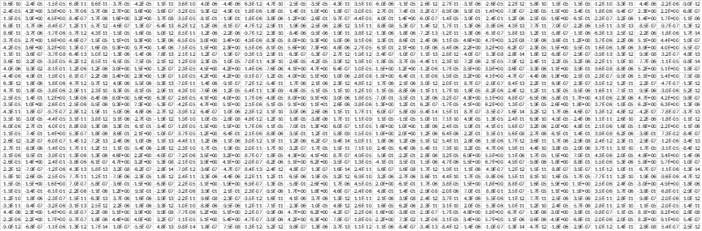
Between Class Scatter (Sb)
Notes:
This is the covariance of the mean vector matrix.
Represents how spread out from each other all the mean vectors are.
You can think of this as the standard deviation of the class vectors
This is symmetrical about the diagonal

Slide 20
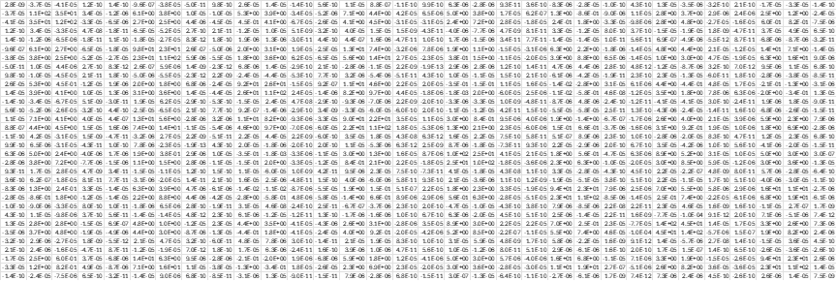
Within Class Scatter (Sw)
Notes:
Within class scatter is the sum of the covariances of each posture in the training data
Represents how spread out the classes are from themselves
Analogous to the standard deviation of the classes
Also symmetrical about the diagonal

Slide 21
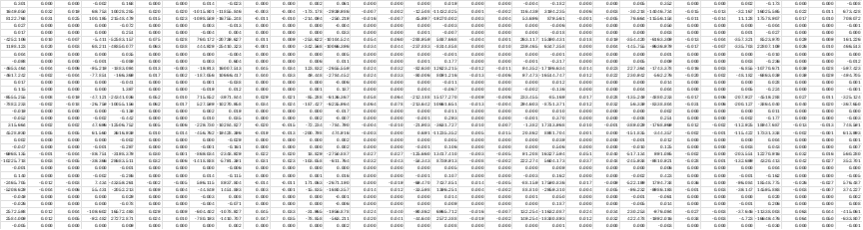
Optimization (O)
Notes:
Ratio of the between class scatter to the within class scatter
Effectively: how spread out are the classes from each other vs. how spread out are they from themselves?

Slide 22
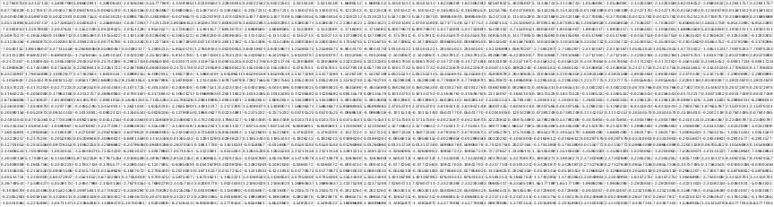
Eigenvectors & Eigenvalues
Notes:
These give us a transformation into a new "space" that maximizes the separation of the classes from each other
This is to make it as easy as possible to distinguish between the different postures
This is obviously still a lot of complexity, and if we kept the full transformation, we'd risk overfitting the model and ironically make it worse
So we look at the eigenvalues to determine which eigenvectors are meaningfully contributing to the shape of our transformation. Generally you'd use something like SVD or PCA to decide your cut off, but in our case after the first 10 eigenvalues they drop off so dramatically as to be effectively 0, giving us a really clear cut off.

Slide 23
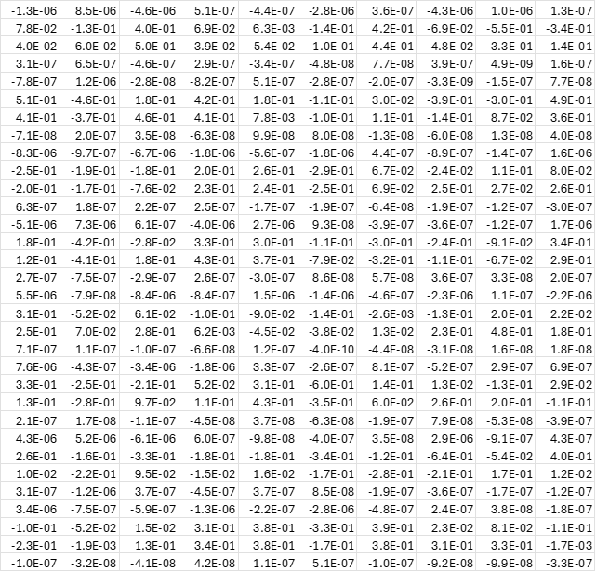
Transformation (W) Matrix
Notes:
Appended Eigenvectors, only the significant ones
Preserves the overall shape of the transformation, without overfitting
Transform the mean vectors, and the validation data
Calculate the distance between a bin of data and each mean vector
Classify that bin as whichever class mean vector it's closest to after the transformation
Repeat for every bin of data
Count how many bins from each validation posture were classified as each posture

Slide 24
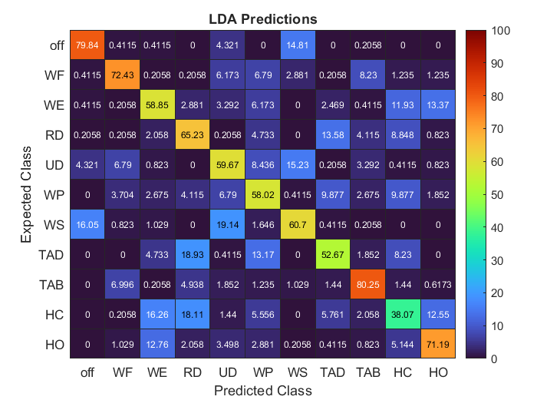
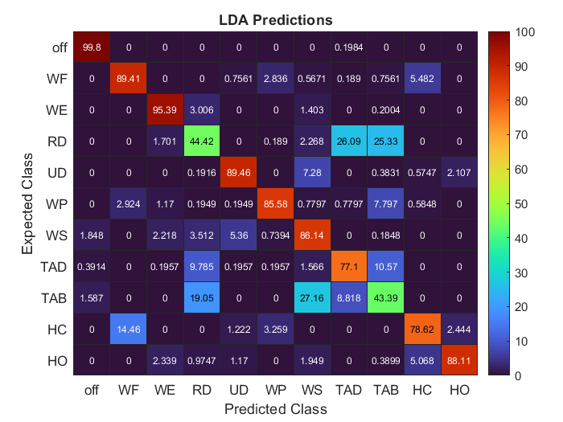
Confusion Matrix
Overall accuracy: 63.36%
Overall accuracy: 82.39%
Notes:
That gives you this confusion matrix, which makes it easy to tell what the model is good at, and what it's not so good at.
In our case, our model is really good at identifying off, wrist flexion, thumb abduction, and hand open postures, ok at most of the others, but not good at identifying the hand closed posture. Over all postures we've achieved an accuracy of 63.36%.

Slide 25
Discussion
Is this good?
What decisions did we make along the way?
What problems arose?
How could we improve the model?
What would we do differently?
Advice for future students
Notes:
From Canvas:
Take-aways
What bin sizes did you use, why?
What coding issues did you have handling large data sets?
What can you say about the identification and removal of the quiescent data? Relevance?
How you would improve your process if you had more time?
Advice for the next class regarding this assignment.

Slide 26
Neural Interfaces and Bionic Limbs Spring 2024
Thank you! | Questions?
Timothy Young, Erin Radcliffe, Sari Younan, Fai Au
GitHub Project Repo

Slide 27
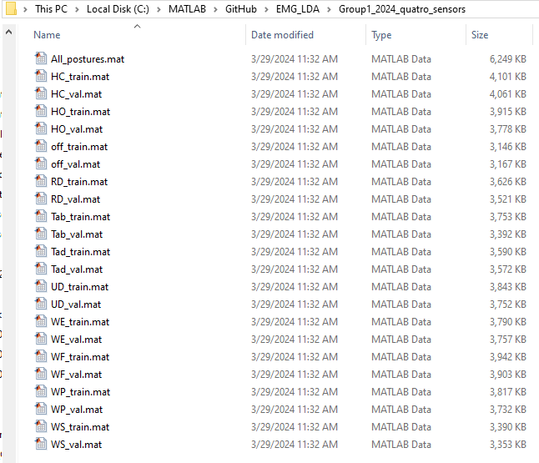
Raw Data Structure – Group 1 Quatros
Each .mat file is a 1x1 struct (named posture) with 4 fields:
Channels (8x25 char)
Fs (2.222222167968750e+03)
Time (8x167761 double)
Data (8x167761 double)
numPostures = 11;
posture_names = {'HC', 'HO', 'off', 'RD', 'Tab', 'Tad', 'UD', 'WE', 'WF', 'WP', 'WS’};
numChannels = 8;
EMG Training Data: 1x1 struct with 11 postures, 8 channels
each field (posture.Data) is a 8x167761 double
EMG Validation Data: 1x1 struct with 11 postures, 8 channels
each field (posture.Data) is a 8x167761 double
Notes:
%% MatLab directory organization
clear all; close all; clc;
main_dir = 'C:\MATLAB\GitHub\EMG_LDA';
raw_data_dir = 'C:\MATLAB\GitHub\EMG_LDA\Group1_2024_quatro_sensors'; % Group 1 EMG
filt_data_dir = 'C:\MATLAB\GitHub\EMG_LDA\Filtered_Group1_2024_quatro_sensors'; % Filtered Group 1 EMG
cd(raw_data_dir)
%% Data exploration: load Raw EMG (Group 1) and save training and validation posture data into separate structs
mat_files = dir('*.mat');
% each mat file is a 1x1 struct (named posture) with 4 fields:
% Channels (8x25 char), Fs (2.222222167968750e+03),
% Time (8x167761 double), Data (8x167761 double)
posture_names = {'HC', 'HO', 'off', 'RD', 'Tab', 'Tad', 'UD', 'WE', 'WF', 'WP', 'WS'};
n_postures = 11;
% Raw EMG training posture data
for i = 1:n_postures
load([posture_names{1,i},'_train.mat'])
emg_train_struct.(posture_names{1,i})= posture.Data;
clear posture
end
% emg_train_struct: 1x1 struct with 11 fields, each field (posture.Data) is a 8x167761 double
clear i;
% Raw EMG validation posture data
for i = 1:n_postures
load([posture_names{1,i},'_val.mat'])
emg_val_struct.(posture_names{1,i})= posture.Data;
clear posture
end
% emg_val_struct: 1x1 struct with 11 fields, each field (posture.Data) is a 8x167761 double
% EMG training data and validation data are equivalent in dimension -->
% save all data in a single storage container
%% Save each Raw EMG mat file struct (posture) in a single cell array
n_files = length(mat_files);
allData_cellArray = cell(cell(n_files, 2));
for i = 1:n_files
% 1st col: name of file struct (posture)
allData_cellArray{i, 1} = mat_files(i).name;
% 2nd col: content of file struct (posture)
allData_cellArray{i, 2} = load(mat_files(i).name);
end
clear i;
%% Plot all channels of Raw EMG per posture
n_channels = height(allData_cellArray{1,2}.posture.Channels);
for i = 1:length(allData_cellArray)
figure(i)
for j = 1:n_channels
subplot(4, 2, j);
plot(allData_cellArray{i,2}.posture.Time(j,:), allData_cellArray{i,2}.posture.Data(j,:));
title("Raw Data, Channel "+ j);
sgtitle(allData_cellArray{i,1}, 'Interpreter', 'none');
ylim([-2e-3, 2e-3]);
end
end

Slide 28
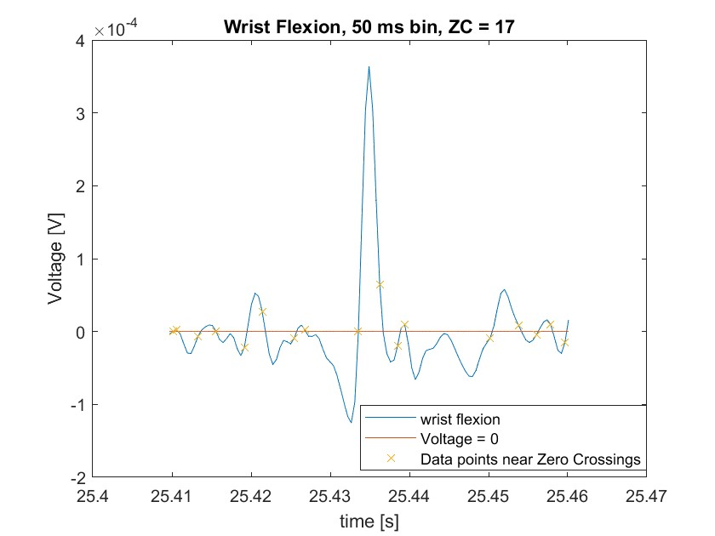
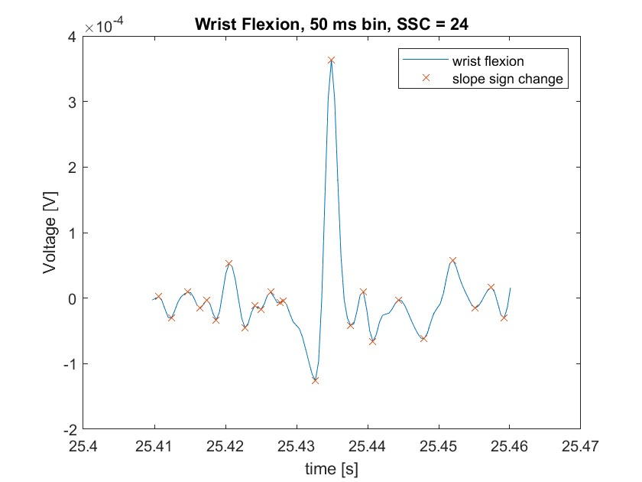
Extraction Features, SSC and ZC scatterplots

